Slide 1
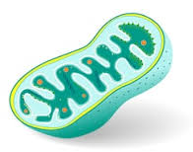
ULTRASTRUCTURE AND FUNCTION OF MITOCHONDRION
Prepared by, Dr. Vijaykumar I.Rane, Head Department of Botany, Jagat Arts, Commerce & I.H.P. Science College, Goregaon Dist-Gondia 441801

Slide 2
DEFINITION
Mitochondria are oxygen-consuming, bean-shaped cellular organelles of immense importance floating free throughout the cell.
They are known as the “powerhouse of the cell” since these organelles supply all the necessary biological energy to the cell by oxidizing the substrates available. The enzymatic oxidation of chemical compounds in the mitochondria releases energy.
Since mitochondria act as the power-houses, they are abundantly found on those sites where energy is earnestly required such as sperm tail, muscle cell, liver cell (up to 1600 mitochondria), microvilli, oocyte (more than 300,000 mitochondria), etc. Typically, there are about 2000 mitochondria per cell, representing around 25% of the cell volume. In 1890, mitochondria were first described by Richard Altmann and he called them bioblasts. Benda in the year 1897 coined the term ‘mitochondrion’.

Slide 3
ULTRASTRUCTUE
Mitochondria are mobile, plastic organelles that have a double-membrane structure. It ranges from 0.5 to 1.0 micrometer in diameter. It has four distinct domains: the outer membrane, the inner membrane, the intermembrane space, and the matrix. The organelle is enclosed by two membranes a smooth outer membrane and a markedly folded or tubular inner mitochondrial membrane, which has a large surface and encloses the matrix space.
The intermembrane space is located between the inner and outer membranes. The number and shape of the mitochondria, as well as the numbers of cristae they have, can differ widely from cell type to cell type.

Slide 4
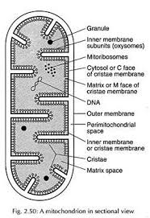
Fig.- Ultrastructure (cross-section) of Mitochondrion

Slide 5
ULTRASTRUCTUE
Tissues with intensive oxidative metabolism e. g., heart muscle have mitochondria with particularly large numbers of cristae. Even within one type of tissue, the shape of the mitochondria can vary depending on their functional status. Both mitochondrial membranes are very rich in proteins.
Outer Mitochondrial Membrane
The outer mitochondrial membrane resembles more with the plasma membrane in structure and chemical composition. Pores in the outer membrane allow small molecules to be exchanged between the cytoplasm and the intermembrane space.
Inner Mitochondrial Membrane
The inner mitochondrial membrane is rich in many enzymes, coenzymes, and other components of electron transport chain. It also contains proton pumps and many permease proteins for the transport of various molecules such as citrates, ADP, phosphate, and ATP.

Slide 6
Inner Mitochondrial Membrane……
The inner mitochondrial membrane gives out finger-like outgrowths called as cristae towards the lumen of the mitochondrion. Associated with the inner membrane several small particles are present. These particles are called elementary particles or subunits of Fernandez-Moran or F₀-F₁ complex or ATPase complex or Oxysomes. Each particle consists of a basepiece, stalk and headpiece. They are spaced about 100 A⁰ intervals. The headpiece is 75-100 A⁰ in diameter and stalk about 50 A⁰ in length.
The inner mitochondrial membrane is completely impermeable even to small molecules (with the exception of O2, CO2, and H2O). Numerous transporters in the inner membrane ensure the import and export of important metabolites

Slide 7
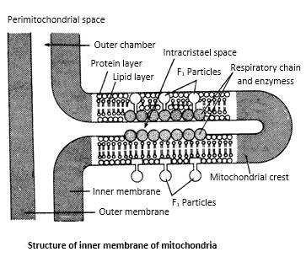
Intermembrane Space
It is the space between the outer and inner membrane of the mitochondria, it has the same composition as that of the cell’s cytoplasm. There is a difference in the protein content in the intermembrane space.

Slide 8
Mitochondrial Matrix
The mitochondrial matrix which is the liquid (colloidal) area encircled by the inner membrane, contains the soluble enzymes of the Krebs cycle which completely oxidize the acetyl-CoA to produce CO2, H2O and hydrogen ions. Hydrogen ions reduce the molecules of NAD and FAD, both of which pass on hydrogen ions to respiratory or electron transport chain where oxidative phosphorylation takes place to generate energy-rich ATP molecules.
Mitochondria also contain in their matrix single or double circular and double-stranded DNA molecules called mt DNA and also the 55S ribosomes, called mitoribosomes. Since mitochondria can synthesize 10 percent of their proteins in their own protein-synthetic machinery, they are considered as semi-autonomous organelles.

Slide 9
Components of the Electron Transport Chain
The respiratory chain , consists of a series of protiens, located in the inner membrane of mitochondria. Five complexes have been identified: four of them (I-IV) constitute electron transport system and the rest (V) is the ATP synthesizing system. Elementary particles contain complex V while other componenets are embedded within the inner membrane.
Complex I (NADH dehydrogenase)
It contains FMN, which accepts 2 electrons and H + from 2 NADH to become the reduced form of FMNH₂; also contains iron atoms, which assist in the transfer of the e − and H + to coenzyme Q.
Complex II (Succinate dehydrogenase)
Contains iron and succinate, which oxidizes FAD to form FADH₂
Coenzyme Q
Accepts electrons from FMNH₂ (complex I) and FADH₂ (complex II) and transfers electrons to complex III.

Slide 10
Complex III (cytochrome b)
It contains heme group, in which the Fe 3+ accepts the electrons from coenzyme Q to become Fe 2+. Transfers electrons to cytochrome c.
Cytochrome c
It contains the heme group, in which the Fe 3+ accepts the electrons from complex III to become Fe 2+. Transfers electrons to complex IV.
Complex IV (cytochrome a)
It contains the heme group, in which the Fe 3+ accepts electrons from cytochrome c to become Fe 2+. Transfers electrons to O₂, which is combined with hydrogen to form H₂O.
Complex V (ATP synthase)
It contains a proton channel that allows for protons to cross into the matrix, using the proton gradient energy to form ATP.

Slide 11
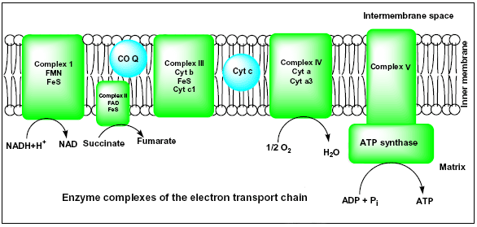

Slide 12
FUNCTIONS
The most important function of mitochondria is to produce energy.
Mitochondria produce the molecule adenosine triphosphate (ATP), one of the cell’s energy currencies that provide the energy to drive a host of cellular reactions and mechanisms.
The simpler molecules of nutrition are sent to the mitochondria to be processed and to produce charged molecules. These charged molecules combine with oxygen and produce ATP molecules. This process is known as oxidative phosphorylation.
They are the respiratory centre of the cells and found enzymes in matrix for Krebs cycle.
The enzymes for electron transport are located in inner membrane of mitochondria.
Mitochondria may also produce heat (brown fat), and accumulate iron-containing pigments (Heme ferritin), ions of Ca2+ and HPO₄^{2–} (or phosphate; e.g., osteoblasts of bones or yolk proteins).

Slide 13
FUNCTIONS conti….
Mitochondria help the cells to maintain the proper concentration of calcium ions within the compartments of the cell.
The mitochondria also help in building certain parts of blood and hormones like testosterone and estrogen.
The liver cell’s mitochondria have enzymes that detoxify ammonia.
The mitochondria also play an important role in the process of apoptosis or programmed cell death.
Abnormal death of cells due to the dysfunction of mitochondria can affect the function of an organ.
Mitochondrial genes control some hereditary characters e.g., male sterility in maize.

Slide 14
Thanks to all……

